Slide 1
Year 13 2017

Slide 2
Programme
Welcome: Matt Bertram (Headmaster)
Your reference
Bruce Smith (Deputy Headmaster)
Academic expectations
Being a senior leader - opportunities
Del White (Senior Master)
UE/Entry into tertiary courses
Cars and driving
Kane Boulton (Senior Master)
Goal setting (Personal Education Plan)
Dave Russell (Senior Master)
Pastoral Change
Social opportunities
Triangle of Success
Carola Laurs (Careers Advisor)
Scholarship applications
University course and Halls of Residence applications
Careers guidance at NBHS in 2017
GAP year opportunities

Slide 3
References - HM
Many students require a Headmaster’s reference which I base on:
Results from NCEA
Co-curricular activities –participation first, excellence second
Character: what do your teachers regularly observe about you in reports; what may I have observed.
You write this by your actions.

Slide 4
Academic expectations - SM
Students are at school putting their best effort into all of their work. Their uniform and grooming is a good example to other students.
Sporting Code of conduct – requirements around attendance and NCEA completion.
Year 13 Privileges:
  Leaving school during study time.
  Able to leave school grounds at lunchtime.

Slide 5
Leadership opportunities - SM
1. House: House Prefects, organising sports and cultural teams, tutoring.
2. Service: Relay for Life; House initiatives Sport: Coaching and managing teams. Captaining teams. Toe by Toe Reading programme. Tutor class mentoring of Year 9 students.
3. Other: Student groups e.g. S.A.D.D, Library team, Model United Nations, Interact

Slide 6
UE and NCEA Level Three - WH
NCEA Level Three = University Entrance *
60 credits needed BUT 120 available
Endorsements are still the key, especially as a predictor of future success
Endorsements =
14 + merit or excellence credits in a subject (at least 3 external)
50 + merit or excellence credits over a level

Slide 7
University Entrance 2017 - WH
14 credits at
Level 3 or higher
In THREE approved
subject
Literacy: 5 reading and 5 writing credits from Level 2
Numeracy:
10 Level 1 or higher maths (or other numeracy) credits
Plus: You MUST have NCEA Level Three.
60 credits at L3 + 20 credits L2 + L1 literacy & numeracy (10 credits of each)

Slide 8
But…
Many universities have adopted a points system or rank score since 2011 whereby the minimum UE requirement will no longer guarantee you a course.
In effect 70+ credits at Level 3 has become the minimum UE entry requirement with the earlier provisos still standing.
See University Websites for specific entry requirements.

Slide 9
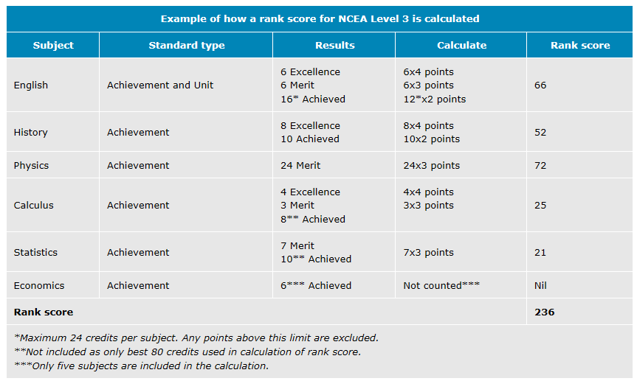
Example: Auck Univ Engineering

Slide 10
Driving to school? - WH
  Yes. But…permission from you, permission from me, permission for passengers
  Parking restrictions for safety

Slide 11
Goal setting - BT
Important that all students set goals early on. These goals should cover academics naturally but also other aspects of school life, eg: sporting, cultural, citizenship.

Slide 12
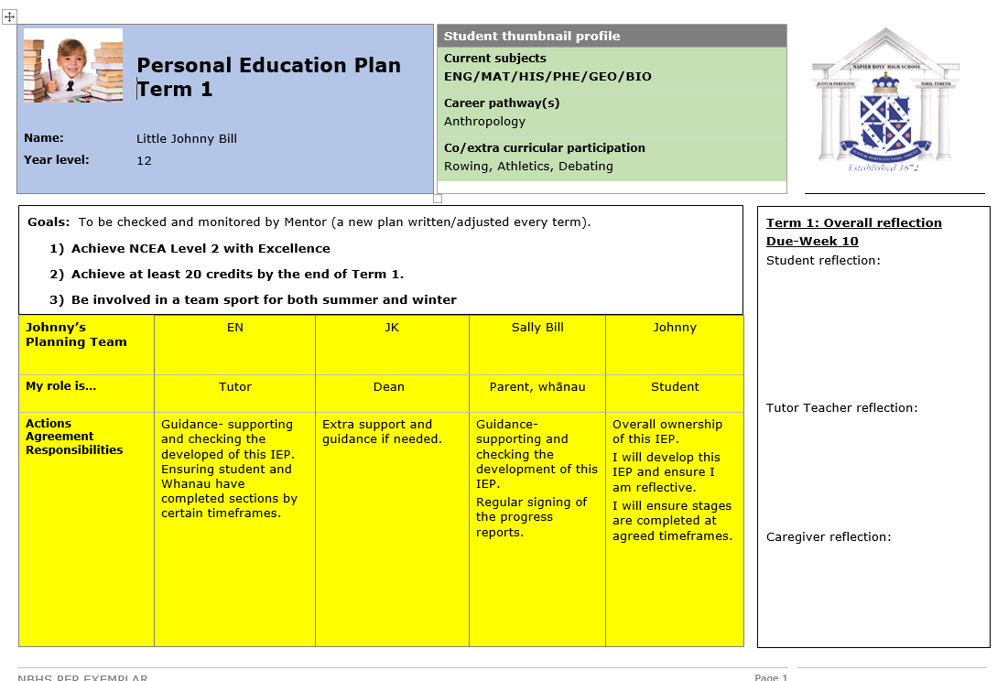
Personal Education Plan’s

Slide 13
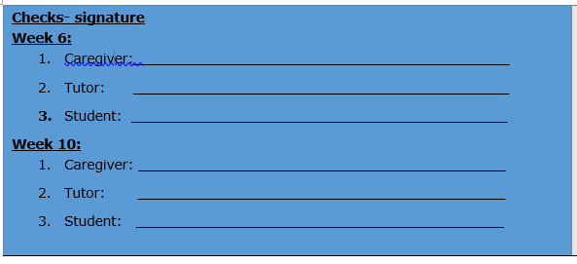
Involving parents and families
Best Evidence Synthesis research says that ‘the involvement of parents and families in a student’s education’ can account for 40% to 65% of achievement.

Slide 14
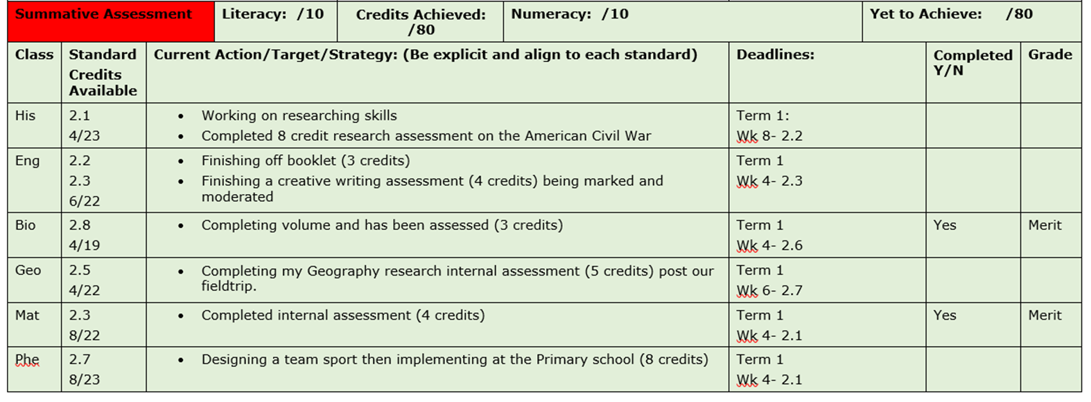
Academic planning and monitoring

Slide 15
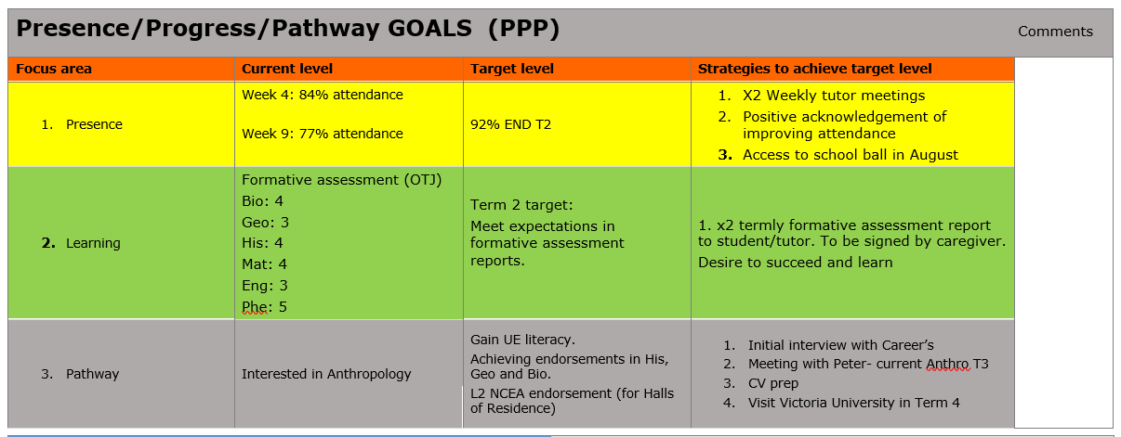

Slide 16
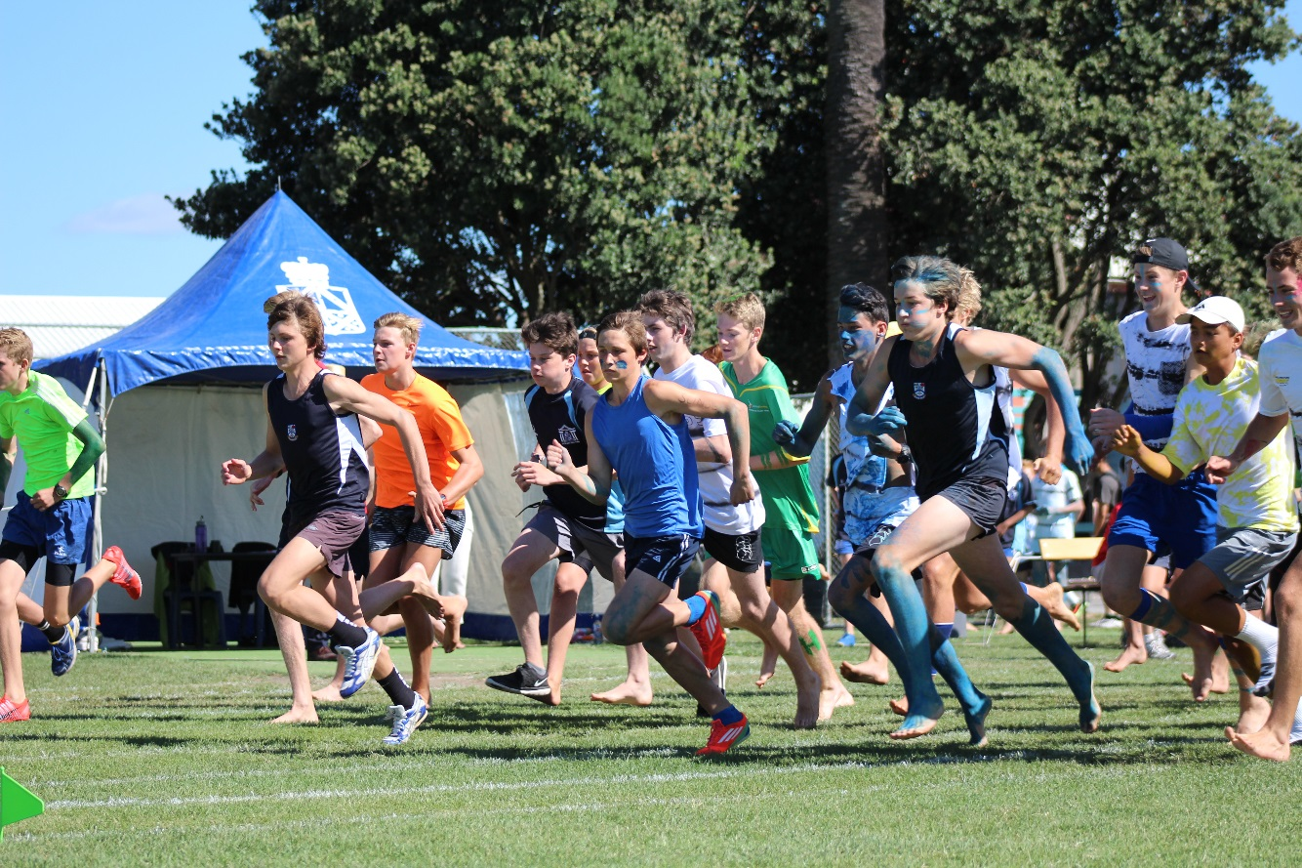
Pastoral - RS
Change to Vertical Structure
Mentoring Year 9 students
House competition

Slide 17
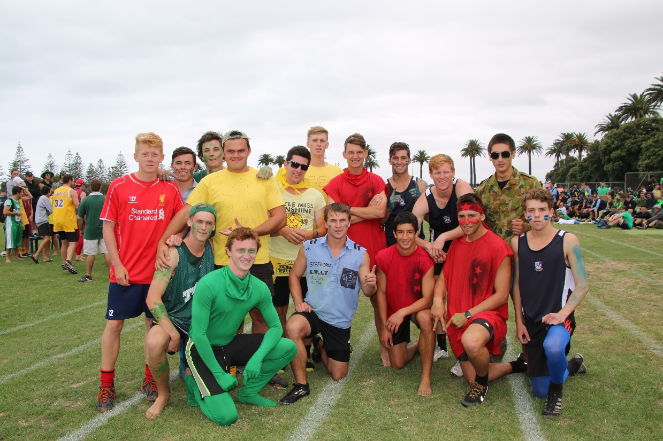
Opportunities & events - RS
Life Balance
Co-curricular opportunities
Ball (Term 3 – 26 August)
Father and son Leavers’ breakfast (Term 4 TBC)

Slide 18

Triangle of Success- RS
KAMAR parent portal
Reports and interviews
Make contact
STUDENT
=
PARENT
SCHOOL

Slide 19
Career Guidance 2017
Carola Laurs
Planning is the key to Success
Careers and counselling department where information is available- appointments for students all year.
NBHS website has Careers information updated
regularly. http://www.nbhs.school.nz/about/pastoral-care/careers-information-and-resources/

Slide 20
Career Interviews for Year 13
All Year 13s have a Career Interview in Term 1 and 2 recorded on KAMAR- You and your son have access -Student Portal
All Year 13s have an exit interview in October- CVs Hostels and Scholarships and Courses have been discussed and enrolled for by early Oct. Courses for University and Polytech - Dec
Term 1 and Term 2 and 3 -University-Polytech liaison- Apprenticeship-Defence- Career Experts to classes
Encourage your son to seek advice. Please pick up the Career Dates/ Budget Planners as you leave

Slide 21
OPTIONS FOR 2017 & BEYOND
A GAP Year
As a volunteer or in paid work. A chance to develop some independence, broaden horizons and sort future plans out. Many students now find work to save for study and have a year off to avoid the student loan.
There are many organisations that will offer various options e.g. http://www.yearoutgroup.org. For a traditional type of GAP year :
Lattitude - http://www.lattitude.org.nz
Tutors Worldwide – www.tutorsworldwide.org

Slide 22
TERTIARY STUDY
Range of courses and providers available at tertiary level is vast- You and your son need to take up the opportunity to visit Open Days and research is essential from the Internet.
University – NZ and/or Overseas – Many specialise, e.g. Canterbury - Engineering, Otago - Health Science
Polytechs – large range of degrees and diplomas; these shouldn’t be discounted as an option e.g. Weltec Automotive Engineering starts at L4→ Degree level
Other providers-programmes e.g. Queenstown Resort College, International College of Hotel Management, Defence Careers, ITOs- ETCO, Master plumber, BCITO, Incubator

Slide 23
FUNDING
Throughout the year many scholarships become available from a variety of sources. Remember there
is fierce competition and they are limited.
It is clearly up to individual students to seek out possible scholarships. But we assist with CVS and Interviews in Term 3.
Breakout
www.breakout.org.nz or www.allaboutfunding.org.nz
The most extensive online information collection of New Zealand scholarships, grants and awards. These can be accessed on any computer at school and Studylink comes in during Term 3 to help sort out student loans and allowances. You and your son need to have conversations regarding his future budget for study. An average cost is now $25,000 a year away from Hawkes Bay.

